Slide 1
Predicting Stock Market Trends using Machine Learning
Jordan Turley

Slide 2
The problem
Predict an increase or decrease in a specific stock on the next day based on previous closing prices

Slide 3
Dataset
S&P 500
Yahoo Finance
Open, high, low, close, adjusted close, volume
Script to fetch closing price each day and determine increase or decrease on final day
Unbalanced: 93 increased next day, 407 decreased
Normalize data

Slide 4
Method 1
Logistic Regression, k-Nearest Neighbors, Support Vector Machines
Stock | X₁ – 4/20/17 | X₂ – 4/21/17 | … | X_{k-1} – 4/18/18 | X_{k} – 4/19/18 | Class
INTC | 36.18 | 36.32 | … | 53.61 | 52.22 | Decrease
MSFT | 65.50 | 66.40 | … | 96.44 | 96.11 | Decrease

Slide 5
LR, kNN, SVM
Use grid search to find optimal values for hyperparameters
Logistic Regression
Penalty norm: L1, L2
C: 0.1, 0.2, … 1.9, 2.0
k-Nearest Neighbors
K = 1, 2, … 10
Distance metric: Euclidian, L1, Manhattan, Chebyshev
Support Vector Machine
Kernel function: linear, sigmoid, rbf, polynomial
C: 0.1, 0.2, … 1.9, 2.0

Slide 6
LR, kNN, SVM
Initial Results
Model | Success Rate (Score)
Logistic Regression | 0.816
k-Nearest Neighbors | 0.8208
Support Vector Machines | 0.816

Slide 7
LR, kNN, SVM
k-Nearest Neighbors
Average F1-score: 0.77
 | Predicted: Decrease | Predicted: Increase
Actual: Decrease | 99 | 2
Actual: Increase | 24 | 0

Slide 8
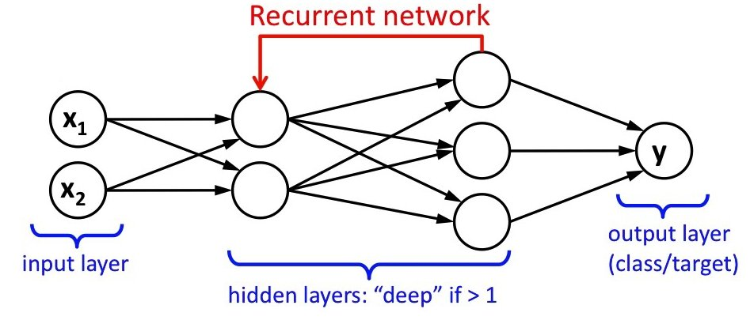
Method 2
Recurrent Neural Network
Time Series
Notes:
Image source: https://leonardoaraujosantos.gitbooks.io/artificial-inteligence/content/image_folder_6/recurrent.jpg

Slide 9
RNN
Each stock gets its own neural network
Each stock consists of several instances
X₁ | X₂ | X₃ | Class
65.50 | 66.40 | 67.53 | Increase
71.41 | 71.47 | 72.55 | Decrease
43.48 | 43.28 | 43.08 | Decrease

Slide 10
RNN
Use grid search again to find optimal parameter values
Days to look back = 1
Blocks = 5
Hidden layers = 3

Slide 11
RNN
Best performing stock: MAT (Mattel toys)
Score: 0.619
Worst performing stock: LB (L Brands fashion)
Score: 0.381

Slide 12
RNN
MAT F1-Score: 0.47
LB F1-Score: 0.21
MAT | Predicted: Decrease | Predicted: Increase
Actual: Decrease | 39 | 0
Actual: Increase | 24 | 0
LB | Predicted: Decrease | Predicted: Increase
Actual: Decrease | 0 | 39
Actual: Increase | 0 | 24

Slide 13
Future work
Larger dataset
More stocks
Back farther in time
More variation, not mostly increase or decrease
Technical Analysis
Try LR, kNN, and SVM with other stock features, like market cap, price-to-earnings ratio, dividend yield… rather than solely the prices
Other models
Naïve Bayes, single perceptron, classical feedforward neural network

Slide 14
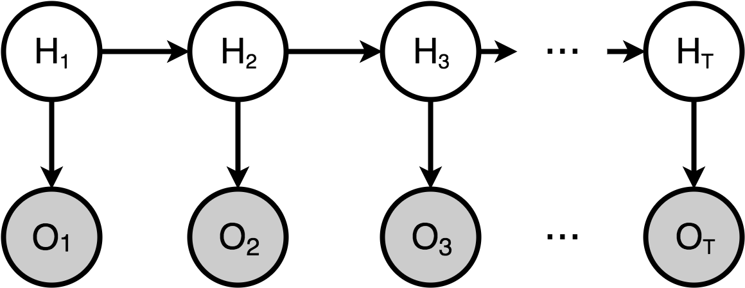
Future Work
Hidden Markov Model
Notes:
https://stathwang.github.io/images/hmm.png

Slide 15
Future Work
Improve RNN
Verify correctness of implementation and usage
Try other hyperparameters
Train for more epochs

Slide 16
Conclusion
The stock market is very hard to predict
Much future work to be done to improve results

